Slide 1
Directions for This Template
Use the Slide Master to make universal changes to the presentation, including inserting your organization’s logo
  “View” tab > “Slide Master”
Replace placeholders (indicated by brackets [ ]) with information specific to your drill
Delete any slides that are not relevant for your drill
Font size should not be smaller than 22pt
Notes:
Organizations can modify and augment this briefing as needed.

Slide 2
Safeguarding Exercise Information
Information in this document is intended for the exclusive use of the drill planners and participants and is not to be released to the public or other personnel without prior approval from the drill organizers [or list specific name].
This document is not releasable to any public website.

Slide 3
[CRC Drill Name]
Player Briefing
[Date]

Slide 4
Welcome
[Name]
[Title (e.g., Drill Director, Actor Controller)]
[Organization]

Slide 5
Agenda
Welcome
Drill Overview
General Drill Concept
Player Instructions
Evaluation
Administrative Details
Notes:
The purpose of the Player Briefing is to address drill parameters, individual roles and responsibilities, safety, security badges, and any remaining logistical exercise concerns or questions.

Slide 6
Drill Overview
Purpose: Evaluate player actions in operating a Community Reception Center (CRC) in a radiation emergency against current CRC plans and procedures.

Slide 7
Drill Scope and Mission Area
Scope
  Type: Drill
  Duration: [planned length]
  Location: [describe general location and layout of drill area]
  Parameters: [what is and what is not included in the drill; for example, drill play is limited to activities within a CRC that has already been set up and staffed]
Mission area
  Response

Slide 8
Drill Participants
[list of participating organizations and their roles in the drill]
Notes:
[Identify any organizations participating that have a limited extent of play.]

Slide 9
Objectives and Core Capabilities
Objective 1: Activate and manage a CRC with the appropriate command structure, assets, and resources to handle [XXX] evacuees over an [X]-hour period.
  Aligns to: Mass Care Services
Objective 2: Conduct radiological monitoring and decontamination operations for potentially contaminated populations.
  Aligns to: Environmental Response/Health and Safety
Objective 3: Conduct radiological assessments to determine if follow-up medical care is needed.
  Aligns to: Public Health and Medical Services
Notes:
Core capabilities are the distinct critical elements necessary to achieve the National Preparedness Goal. During the drill design process, the Drill Planning Team selected drill objectives and them to core capabilities, as shown here. Evaluators will observe and document how drill objectives and capabilities are met through the players’ ability to complete critical tasks and meet capability targets, in accordance with plans, procedures, and protocols for the CRC.

Slide 10
Objectives and Core Capabilities (cont.)
Objective 4: Provide psychosocial support and screen and provide referral for medical needs to sick and injured presenting at the CRC.
  Aligns to: Public Health and Medical Services
Objective 5: Address the communication and information issues related to the operation of the CRC.
  Aligns to: Public Information and Warning

Slide 11
General Drill Concept
Drill covers activities at the CRC once it has been activated, set up, and staffed
Play begins immediately before the arrival of the first actors
Play will generally be driven by the numbers and characteristics of members of the public visiting the CRC. These will be played by volunteer actors who will each have (1) an Actor Card and (2) a Contamination Card

Slide 12
General Drill Concept (cont.)
Each actor will play out the role on his/her Actor Card without showing you the card
  Actor Cards include information about age, gender, etc. as well as any special needs, characteristics, symptoms, or behaviors (e.g., people who do not speak English, have a disability, are children, are upset)
  Players do not see what is on the Actor Card

Slide 13
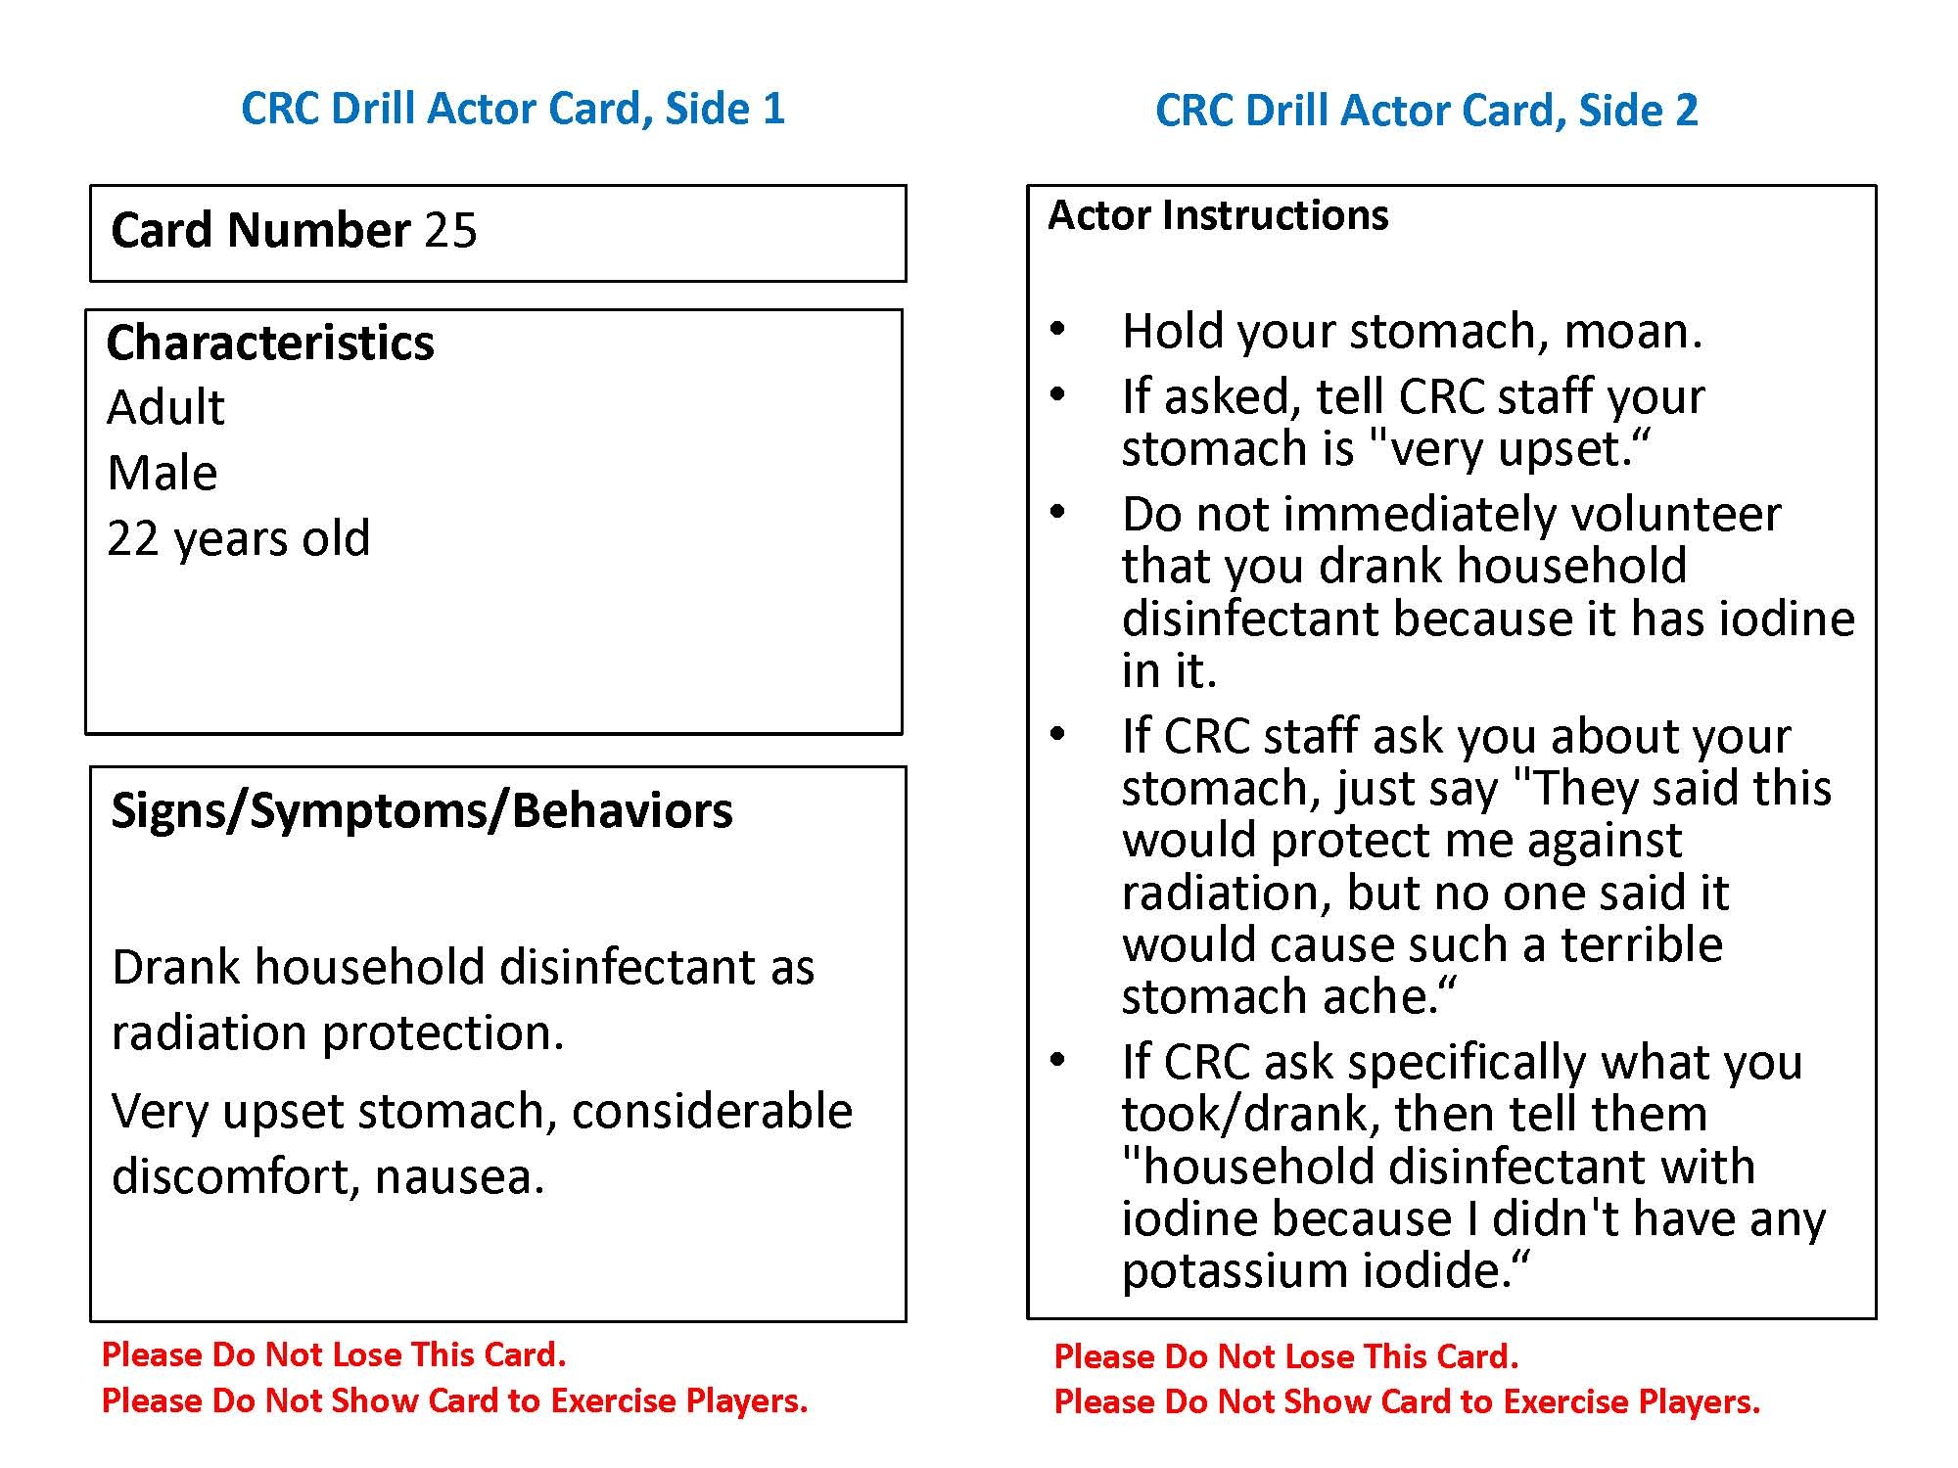
Sample Actor Card

Slide 14
General Drill Concept (cont.)
Each actor will also have a Contamination Card with information about a person’s level of contamination, if any
  Actors will hand these cards to the Radiological Controller assigned to each radiation monitoring lane
    Contamination Screening Station
    Decontamination Station
  The Radiological Controller will observe the technique of players performing the monitoring and provide a simulated meter reading verbally when it is earned
  If the reading is “as read,” the players must record the levels they are actually reading on their instruments
Notes:
Drill play assumes that the cards reflect actual instrument readings and are not necessarily an indication of the activity or specific isotopes on the skin. The derivation of specific instrument readings is not important, because the drill is designed to evaluate the performance of the monitoring staff and not the accuracy of the instruments.
To “earn” a reading, the players performing the monitoring must use their instruments correctly. Readings after decontamination will be based on the Radiological Controller’s observation of the decontamination technique and the expected level of effectiveness.

Slide 15
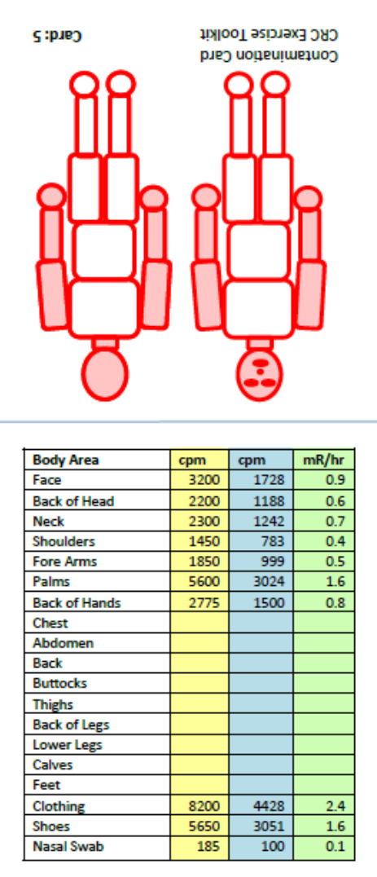
Sample Contamination Card

Slide 16
General Drill Concept (cont.)
Depending on the size of the drill, actors may be asked to go through the CRC multiple times in different roles
Players implement actions as they would in real life within the confines of the CRC
Controllers may call for a “time out” in his or her area to provide clarification or training to players for a critical action [delete if not applicable]
[Otherwise,] controllers and evaluators will not prompt player actions

Slide 17
Drill Assumptions and Artificialities
The drill scenario and events, including simulations, are plausible, and results occur as they are presented
Play is restricted to the delineated areas surrounding drill site
The SimCell will simulate nonparticipating individuals and organizations; to reach them [describe]
Decontamination through showering will be simulated
Radiation detection equipment should be used according to procedure, but readings will be determined from the Contamination Cards
Notes:
In any drill, assumptions and artificialities may be necessary to complete play in the time allotted and/or account for logistical limitations. Drill participants should accept that assumptions and artificialities are inherent in any drill and should not allow these considerations to negatively impact their participation. A full list of assumptions and artificialities is provided in the ExPlan.

Slide 18
Drill Assumptions and Artificialities
Individuals maybe referred to internal dose assessment, but no actual assessment activities will take place
[Actors may tell players they have pets, but no animals will actually be present]
Medical assistance, other than taking vital signs, will be simulated
[List others to highlight, as appropriate]
Notes:
In any drill, assumptions and artificialities may be necessary to complete play in the time allotted and/or account for logistical limitations. Drill participants should accept that assumptions and artificialities are inherent in any drill and should not allow these considerations to negatively impact their participation. A full list of assumptions and artificialities is provided in the ExPlan.

Slide 19
Player Communications
Players use normal channels of communication as called for in CRC plans, procedures, and protocols, with the exception of those to be simulated [detail in new bullet]
Direct any communications intended for non-playing organizations to the SimCell
Begin and end all drill communications (except face-to-face within the CRC) with the statement: “This is a drill”
In the event of a real emergency, say “This is a real-world emergency”

Slide 20
Safety
Safety is EVERYONE’S concern
  Safety concerns override drill execution
  Alert the nearest controller if you have safety concerns
The Safety Controller for this drill is [Name]
Actual emergencies will be identified by saying “This is a real emergency”
Report any injuries
Be aware that operating in an operations-based exercise environment is inherently dangerous

Slide 21
Drill Area
[Maps]

Slide 22
Security
Badges identify authorized persons:
Controllers Green badges
Evaluators Red badges
Support staff Brown badges
Players Yellow badges
Observers Blue badges
Media Pink badges
Actors Orange badges
Unauthorized persons are not permitted at the drill. If you see unidentified or unauthorized persons at the site, notify a controller immediately. Unauthorized persons will be escorted out of the drill area
Notes:
[Modify the badge colors or identification to be used accordingly. Note if there are special designators, such as a colored hat, for Drill Director, Lead Controller, Lead Evaluator, Actor Controller, Observer/Media/VIP Controller.]

Slide 23
Observers, Media, and VIPs
May stay in designated observation areas, but are not permitted in areas where drill play is taking place
Should not interfere with play or talk with players
Will be escorted by [name]
Will remain in a dedicated area
Notes:
Observers, media representatives, and VIPs may be present but are not permitted in drill play areas and should not talk to players; they will be escorted by a controller at all times

Slide 24
Drill Schedule
Player briefing: [Date/time]
Drill: [Date]
  Participant registration: [Time]
  Final participant instructions: [Time]
  Participants in place: [Time]
  Start of drill (StartEx): [Time]
  End of drill (EndEx): [Time]
  Actor Debriefing: Immediately after EndEx
  Hot Wash: Immediately after EndEx, for about 30 minutes
Cleanup
Notes:
Note if the full Hot Wash will be preceded by smaller Hot Washes in each individual area of the CRC.

Slide 25
Player Instructions during the Drill
DO
  Conduct operations as normally as possible, as called for in CRC plans, procedures, and protocols
  Actually perform needed actions, except as noted previously for simulation or as directed by a controller or evaluator
  State aloud any actions taken that are not obvious to the evaluator and keep notes of such actions if possible (Appendix A of Player Handbook)
  Follow safety guidelines
  Wear your drill ID badge

Slide 26
Player Instructions during the Drill (cont.)
DO NOT
  Have personal conversations with drill controllers and evaluators
  Ask a controller or evaluator to prompt you on a specific response
  Ask to see an actor’s Symptomology Cards
  Photograph, video, or record drill players, actors, or activity without permission of the drill organizers
  Distribute, release, tweet, upload, post, etc. drill information without permission of the drill organizers

Slide 27
Player Roles after the Drill
Participate in the Hot Wash
Complete and submit your Participant Feedback Form
Provide copies of all logs, notes, and other documentation to the controllers
Assist in cleanup as requested
[Additional reminders as needed]

Slide 28
Evaluation Overview
The goal of drill evaluation is to validate strengths and identify improvement areas for participants
Validate plans, procedures, and protocols:
  Were established plans, procedures, and protocols followed?
  Were plans, procedures, and protocols effective?
  What new or unanticipated challenges and issues arose?
  What level of capability was established?
Evaluation is accomplished by:
  Observing the event and collecting supporting data
  Analyzing the data to compare performance against expected outcomes
  Identifying strengths and areas for improvement
  Recommending changes to ensure expected outcomes

Slide 29
CRC Drill Evaluation
The drill will be conducted in a no-fault learning environment and systems; processes, not individuals, will be evaluated
Evaluation provides an opportunity to identify ways to build on strengths and improve capabilities
Because jurisdictions are testing new and emerging plans, skills, resources, and relationships, every drill can be expected to result in multiple recommendations for improvement
Evaluators will observe player actions and hear conversations and take notes
Evaluators will not provide feedback during play but may ask questions to fully understand and document player actions

Slide 30
CRC Drill Evaluation (cont.)
Player input to evaluation through:
  Hot Wash immediately after drill at stations and among full CRC
  Participant Feedback Forms
  Any other logs or notes
Evaluators compile an After-Action Report (AAR)
After-Action Meeting
  Elected and appointed officials review the AAR and identify corrective actions in an Improvement Plan
Notes:
The Hot Wash and Participant Feedback Forms provide an opportunity for players to express opinions about the drill and their own performance.

Slide 31
Administrative Details
[Parking and transportation]
[Security/access restrictions]
[Restroom locations]
[Food and water]
[Smoking policy]
[Drill cleanup]
[Others as necessary]
After the Hot Wash, please return:
  All badges
  All documentation (notes/logs)
  Participant feedback form
Notes:
[The first two bullets on parking and security assume that this briefing is being given before the drill, not on site. Delete if no longer relevant.]

Slide 32
Questions?

